Slide 1
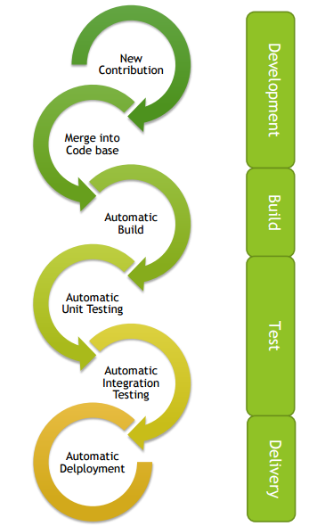
Continuous Delivery, Continuous Quality & GitHub
DevOps – 4 ECTS
Abhishek Kumar, abhishek.kumar@hamk.fi
Slides from Deepak KC

Slide 2
At this point
You are familiar with Azure DevOps.
You have Azure DevOps account. (You can use HAMK student ID to login.
You have created an organization and a project in Azure DevOps and is familiar with the Azure DevOps user interface.
You have a team and one of the member has created a Project and have added all other team members to work in the project.

Slide 3
Delivery Plans
It refers to a feature of Azure DevOps that enables users to visualize and track the progress of work across multiple teams, projects, and sprints.
It provides a high-level view of work items, such as user stories, bugs, and features, and their associated status and dependencies.
With Delivery Plans, you can
Create a timeline that shows work items from multiple teams, projects, and sprints.
Track the status of work items, such as new, in progress, and completed.
Visualize dependencies between work items and teams.
Monitor progress and identify potential roadblocks or delays.
Collaborate and communicate with team members and stakeholders.

Slide 4
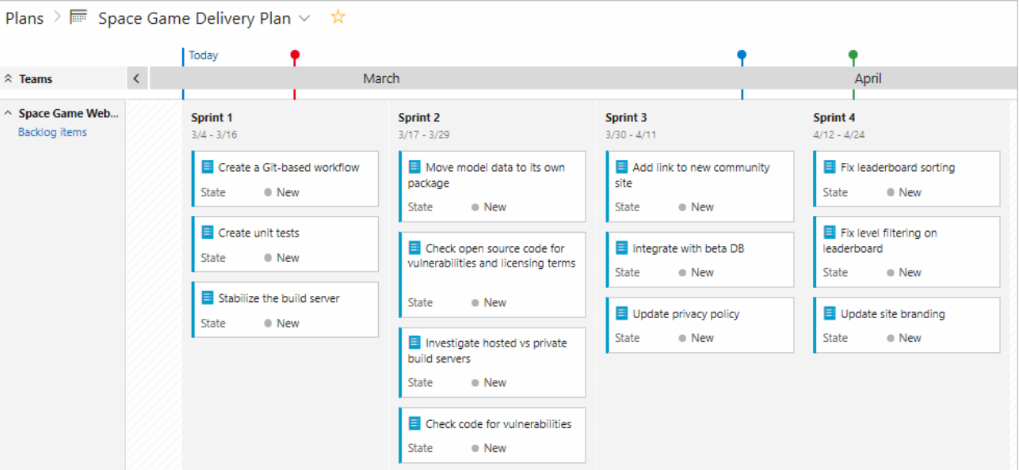
Delivery Plans
“Delivery plans add value at any point in a project's lifecycle. Since they are dynamically generated based on team backlogs, they're always up-to-date and offer the latest insights.”

Slide 5
Continuous Delivery
A software engineering approach in which as teams produce software in short cycles ensuring that the software can be
Reliably released at any time
Released manually
Why CD?
Build, test, and release software with greater speed and frequency
Reduce the cost, time, and risk of delivering changes by allowing for more incremental updates to applications in production
https://docs.microsoft.com/en-us/learn/modules/explain-devops-continous-delivery-quality/

Slide 6
Continuous Delivery happens when:
Software is deployable throughout its lifecycle
Continuous Integration as well as extensive automation are available through all possible parts of the delivery process, typically using a deployment pipeline
It’s possible to perform push-button deployments of any version of the software to any environment on demand

Slide 7
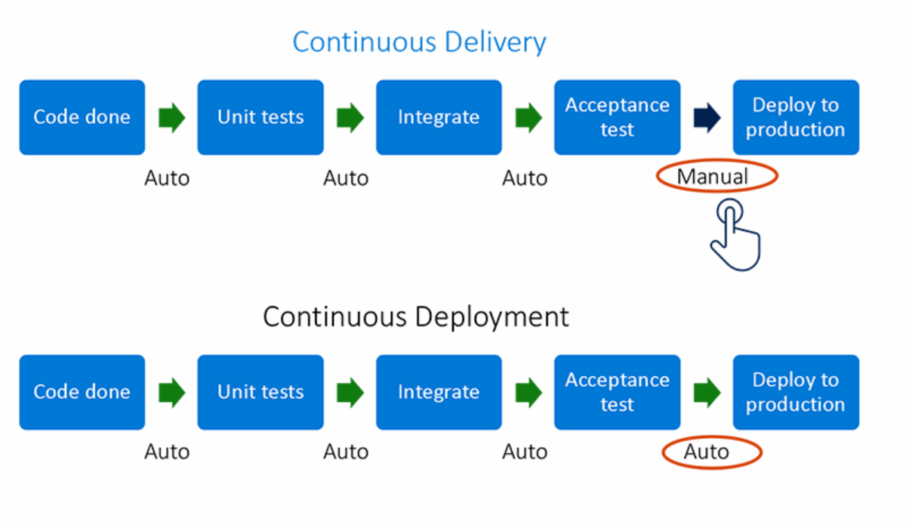

Slide 8
Benefits of Continuous Delivery
Less waste
Faster ROI
Lower risk
Higher quality
Early feedback
Better planning
Faster collaboration
Everyone is involved
Fewer production issues
Ability to shift left on security
Adapt and react a lot more quickly

Slide 9
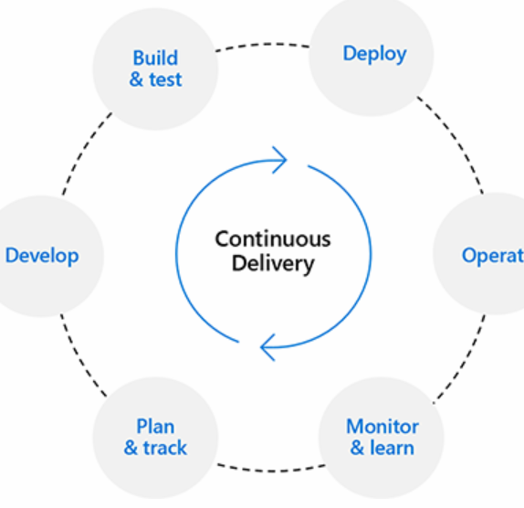
High-performing DevOps organizations when compared to low performers achieve:
More than 200 times more frequent deployments
More than 100 times faster lead time for changes
More than 2600 times faster mean time to recover
Seven times lower change failure rate

Slide 10
Continuous delivery is not Continuous Deployment
Continuous Deployment means that every change goes through the pipeline and automatically gets put into production, resulting in many production deployments every day.
Continuous Delivery just means that you can do frequent deployments but may choose not to, usually due to businesses preferring a slower rate of deployment. You must be doing Continuous Delivery to do Continuous Deployment.
Continuous Integration is a prerequisite for Continuous Delivery.

Slide 11
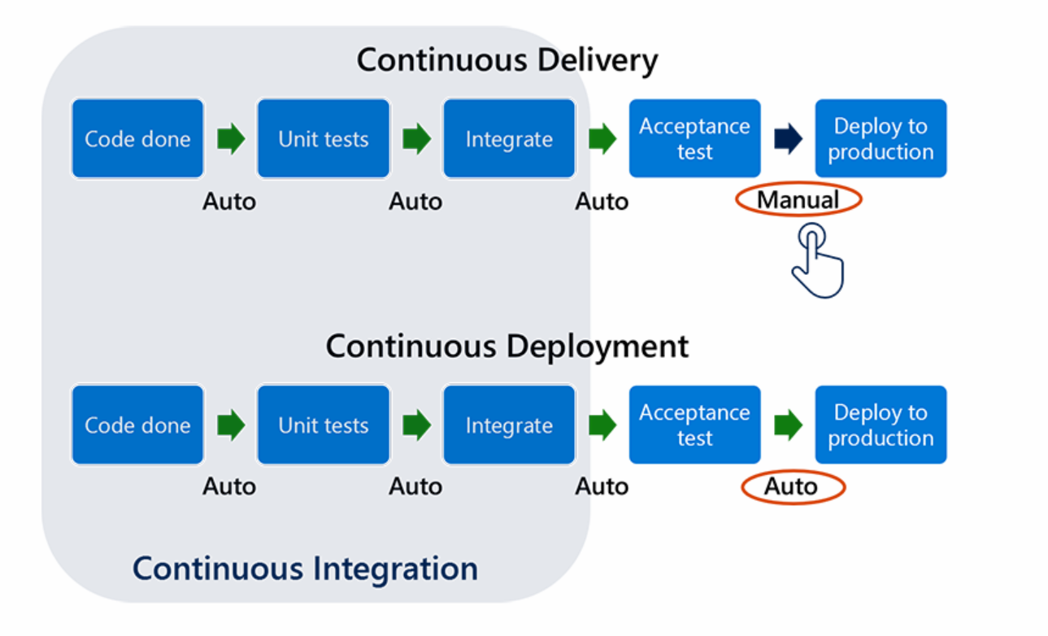

Slide 12
Continuous Quality
An approach to find and fix software defects during all phases of software development cycle
To make products scalable.
To reduce costs.
To set you apart from competition.
A "quality-first" mindset that promotes a shared responsibility for quality.
Reduction of waste due to frequent rework caused by defects.
Less technical debt due to missing quality requirements accumulating over time.
Greater customer satisfaction.
Fewer incidents that disrupt the business.

Slide 13
Focus on quality results in significant savings of time and effort.
It costs 5X if defect is found in the development phase.
It costs 10X if defect is found in integration testing.
It costs 15X if defect is found in user acceptance testing.
It costs 30X if defect is found in post product release.

Slide 14
A quality culture
Create superior user experiences
Build features that fit the market’s timing
Enable the characteristics of an application that deliver value faster than they create technical debt

Slide 15
A Continuous Quality mindset:
Encourages growth and innovation and creates the culture that enables and nurtures quality-driven behaviors.
Knows that quality is built-in, that it can’t be tested-in.
Prioritizes quality over new features.
Advocates teamwork.
Takes responsibility for deliverables.
Shifts testing sideways.

Slide 16
Practical Task
Set up your environment
https://docs.microsoft.com/en-us/learn/modules/manage-delivery-plans/4-set-up-environment
Plan a sprint using Delivery Plans
https://docs.microsoft.com/en-us/learn/modules/manage-delivery-plans/5-plan-sprint-delivery-plans

Slide 17
References
https://docs.microsoft.com/en-us/learn/modules/manage-delivery-plans/2-what-are-delivery-plans
https://azure.microsoft.com/en-us/overview/what-is-devops/
https://docs.microsoft.com/en-us/learn/modules/get-started-with-devops/3-what-is-azure-devops

